Slide 1
Catia: FEA with Analytical Solution
Zakaria Alghamdi

Slide 2
Applying Von-mises study
C-Clamp shape
Goal:
To determine Maximum Circumferential Stresses values using:
TK Solver
SolidWorks FEA
Catia FEA

Slide 3
Task
Max Stress on section AB
Max Stress on section DE
P = 3000 lb

Slide 4
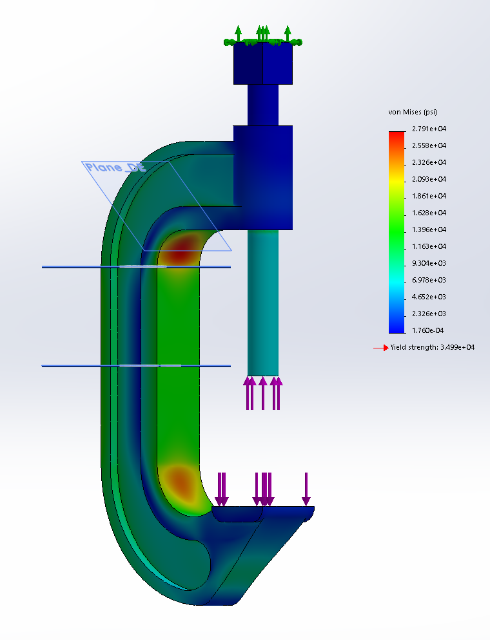
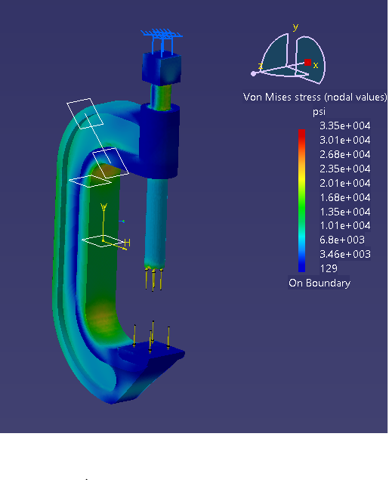
outline
1- FEA approach in SolidWorks
2-FEA approach in CATIA
3-results

Slide 5
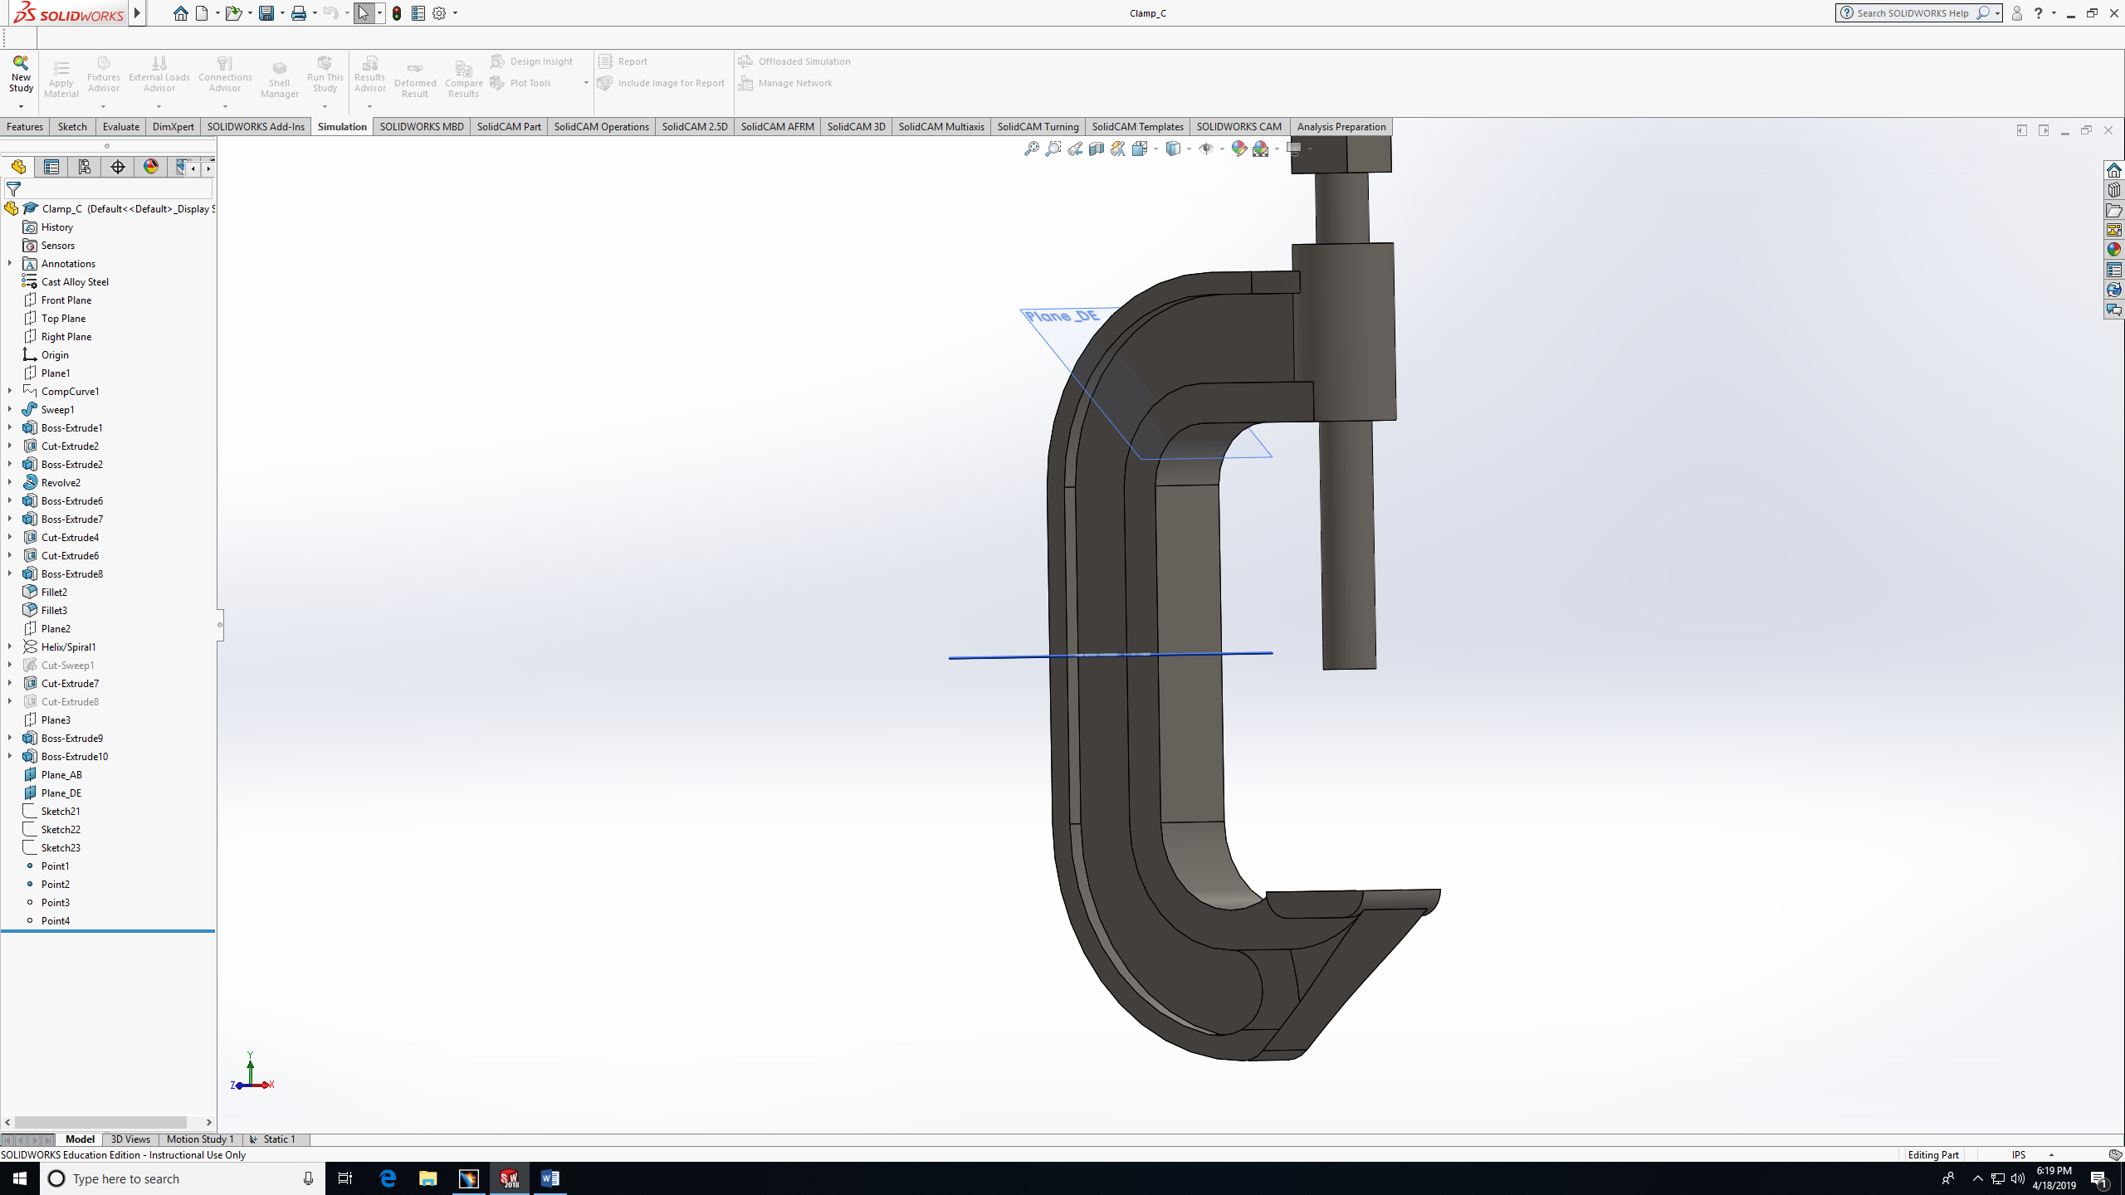
1- FEA approach in SolidWorks

Slide 6
Things need to do :
Add fixture
Add load
Choose the size of the mesh
Change the stress to Von-Mises
Choose the Location

Slide 7
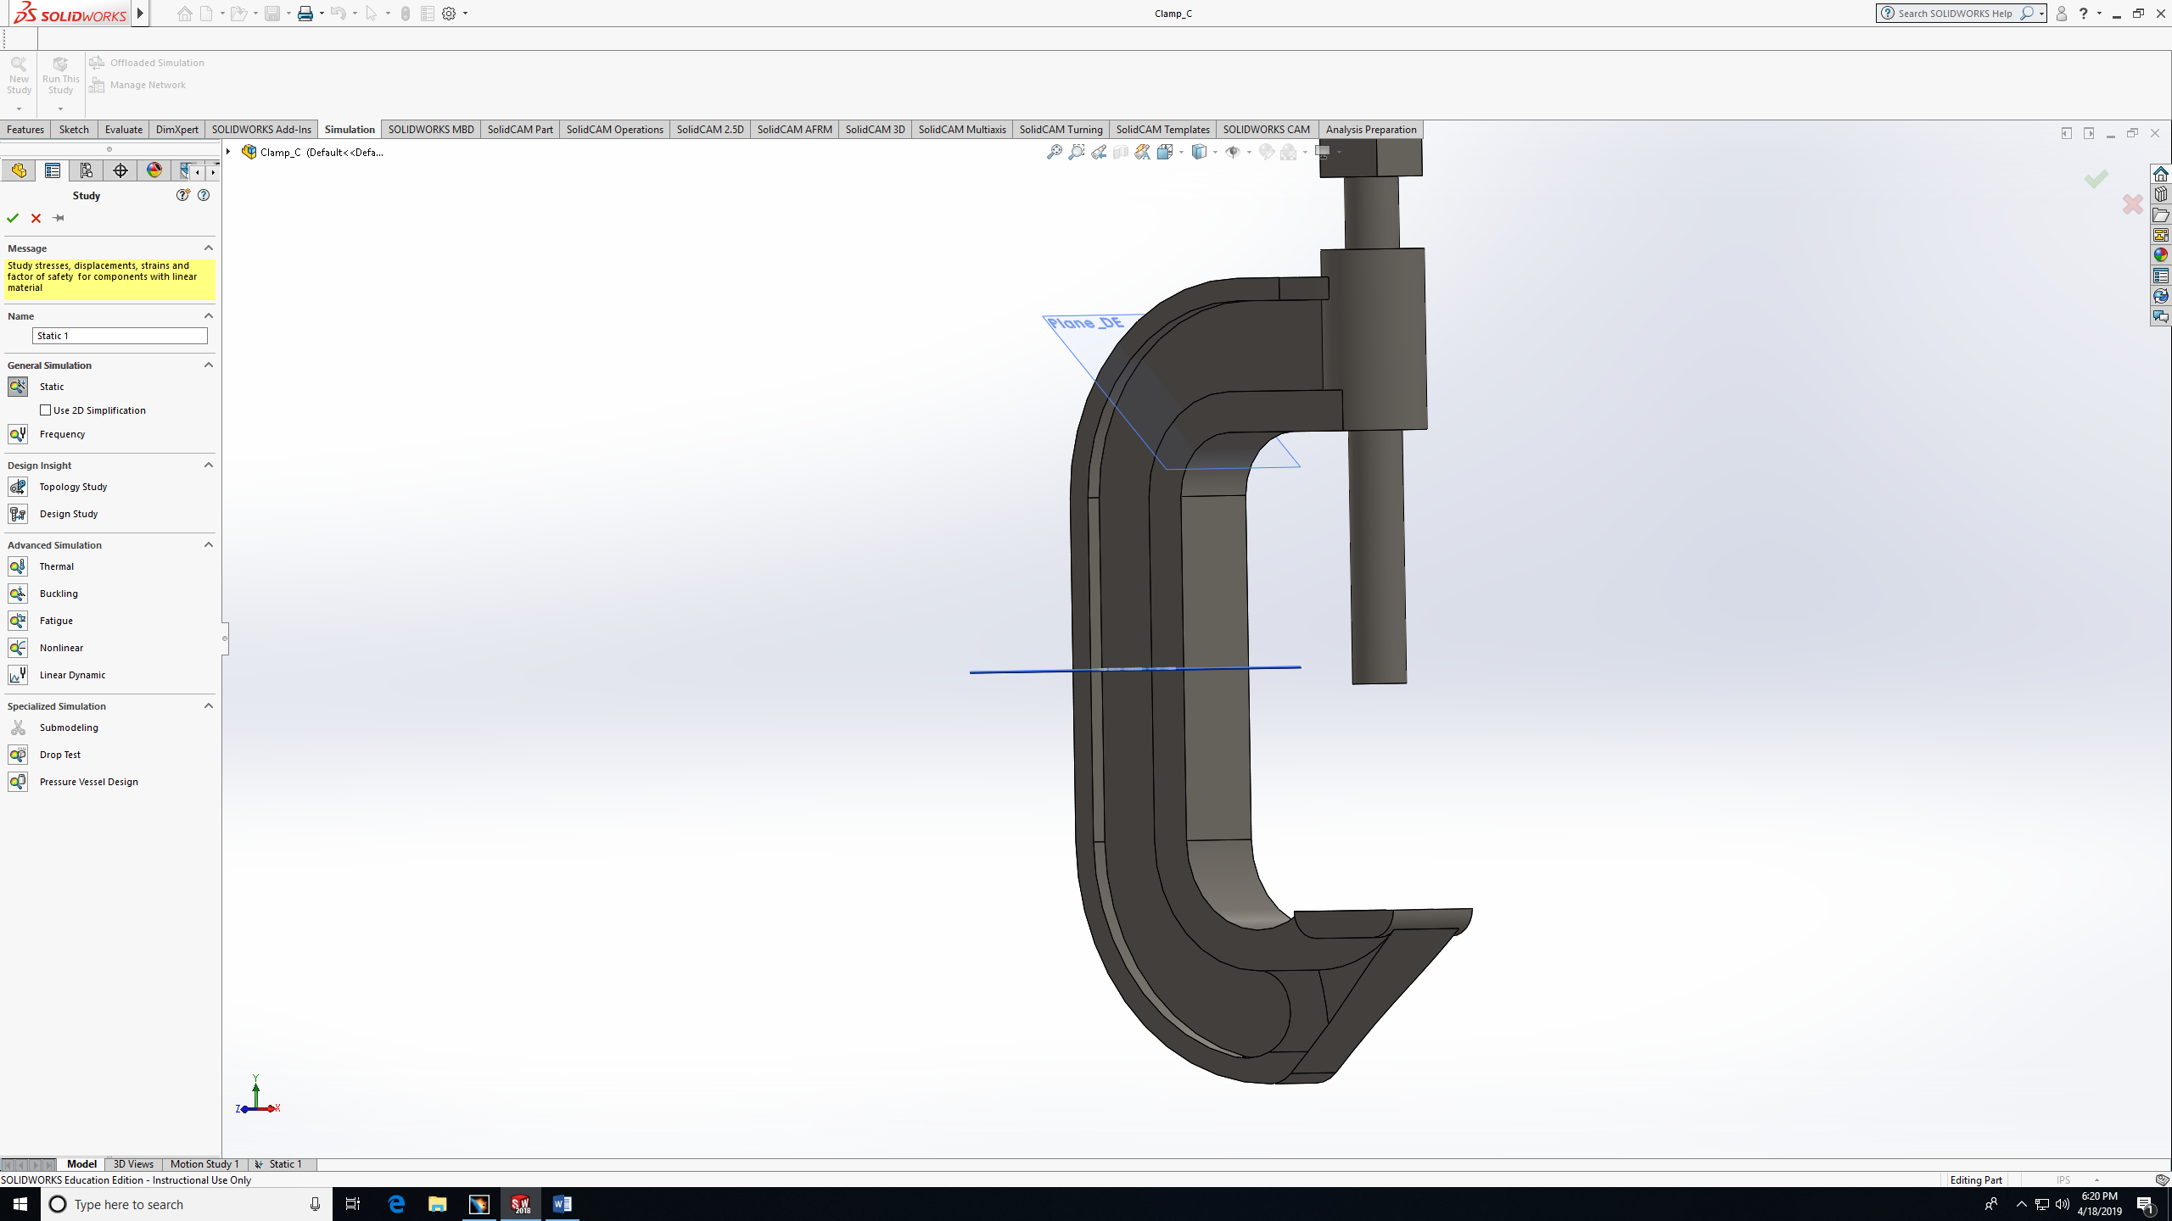
Step 1 (static study)

Slide 8
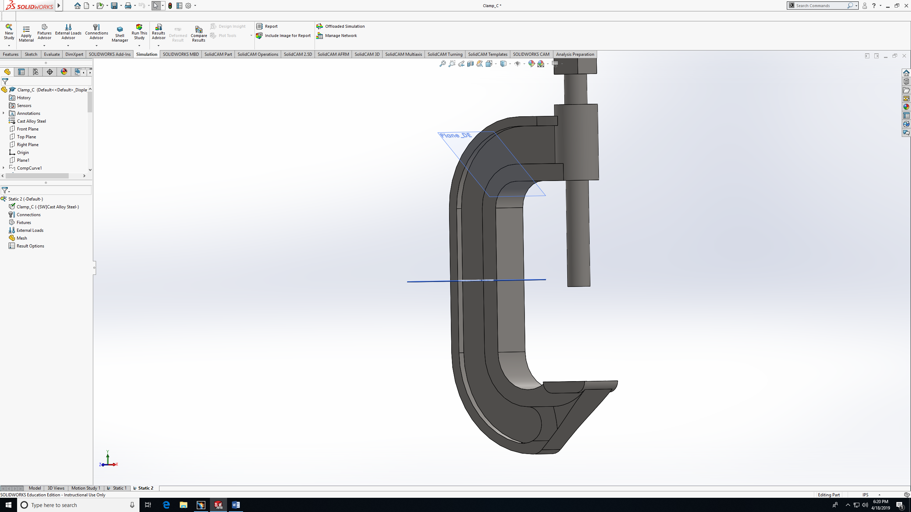
Step 2 (simulation features)

Slide 9
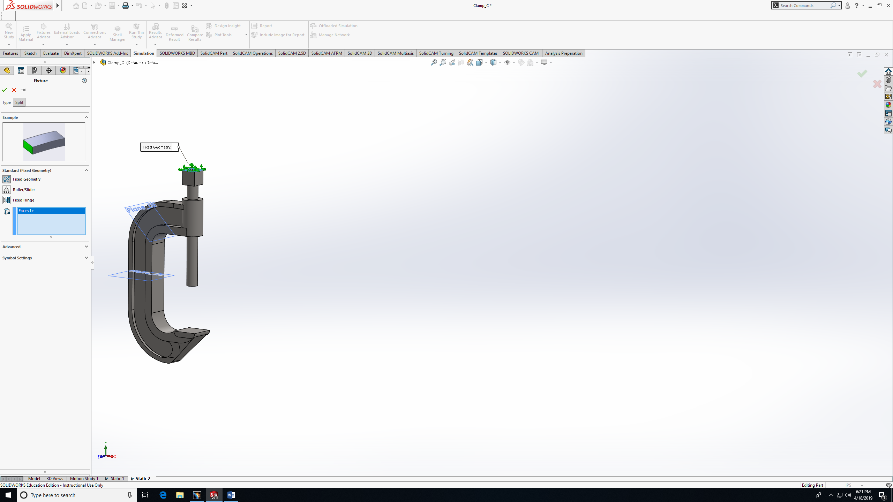
Step 3 (fixed geometry)

Slide 10
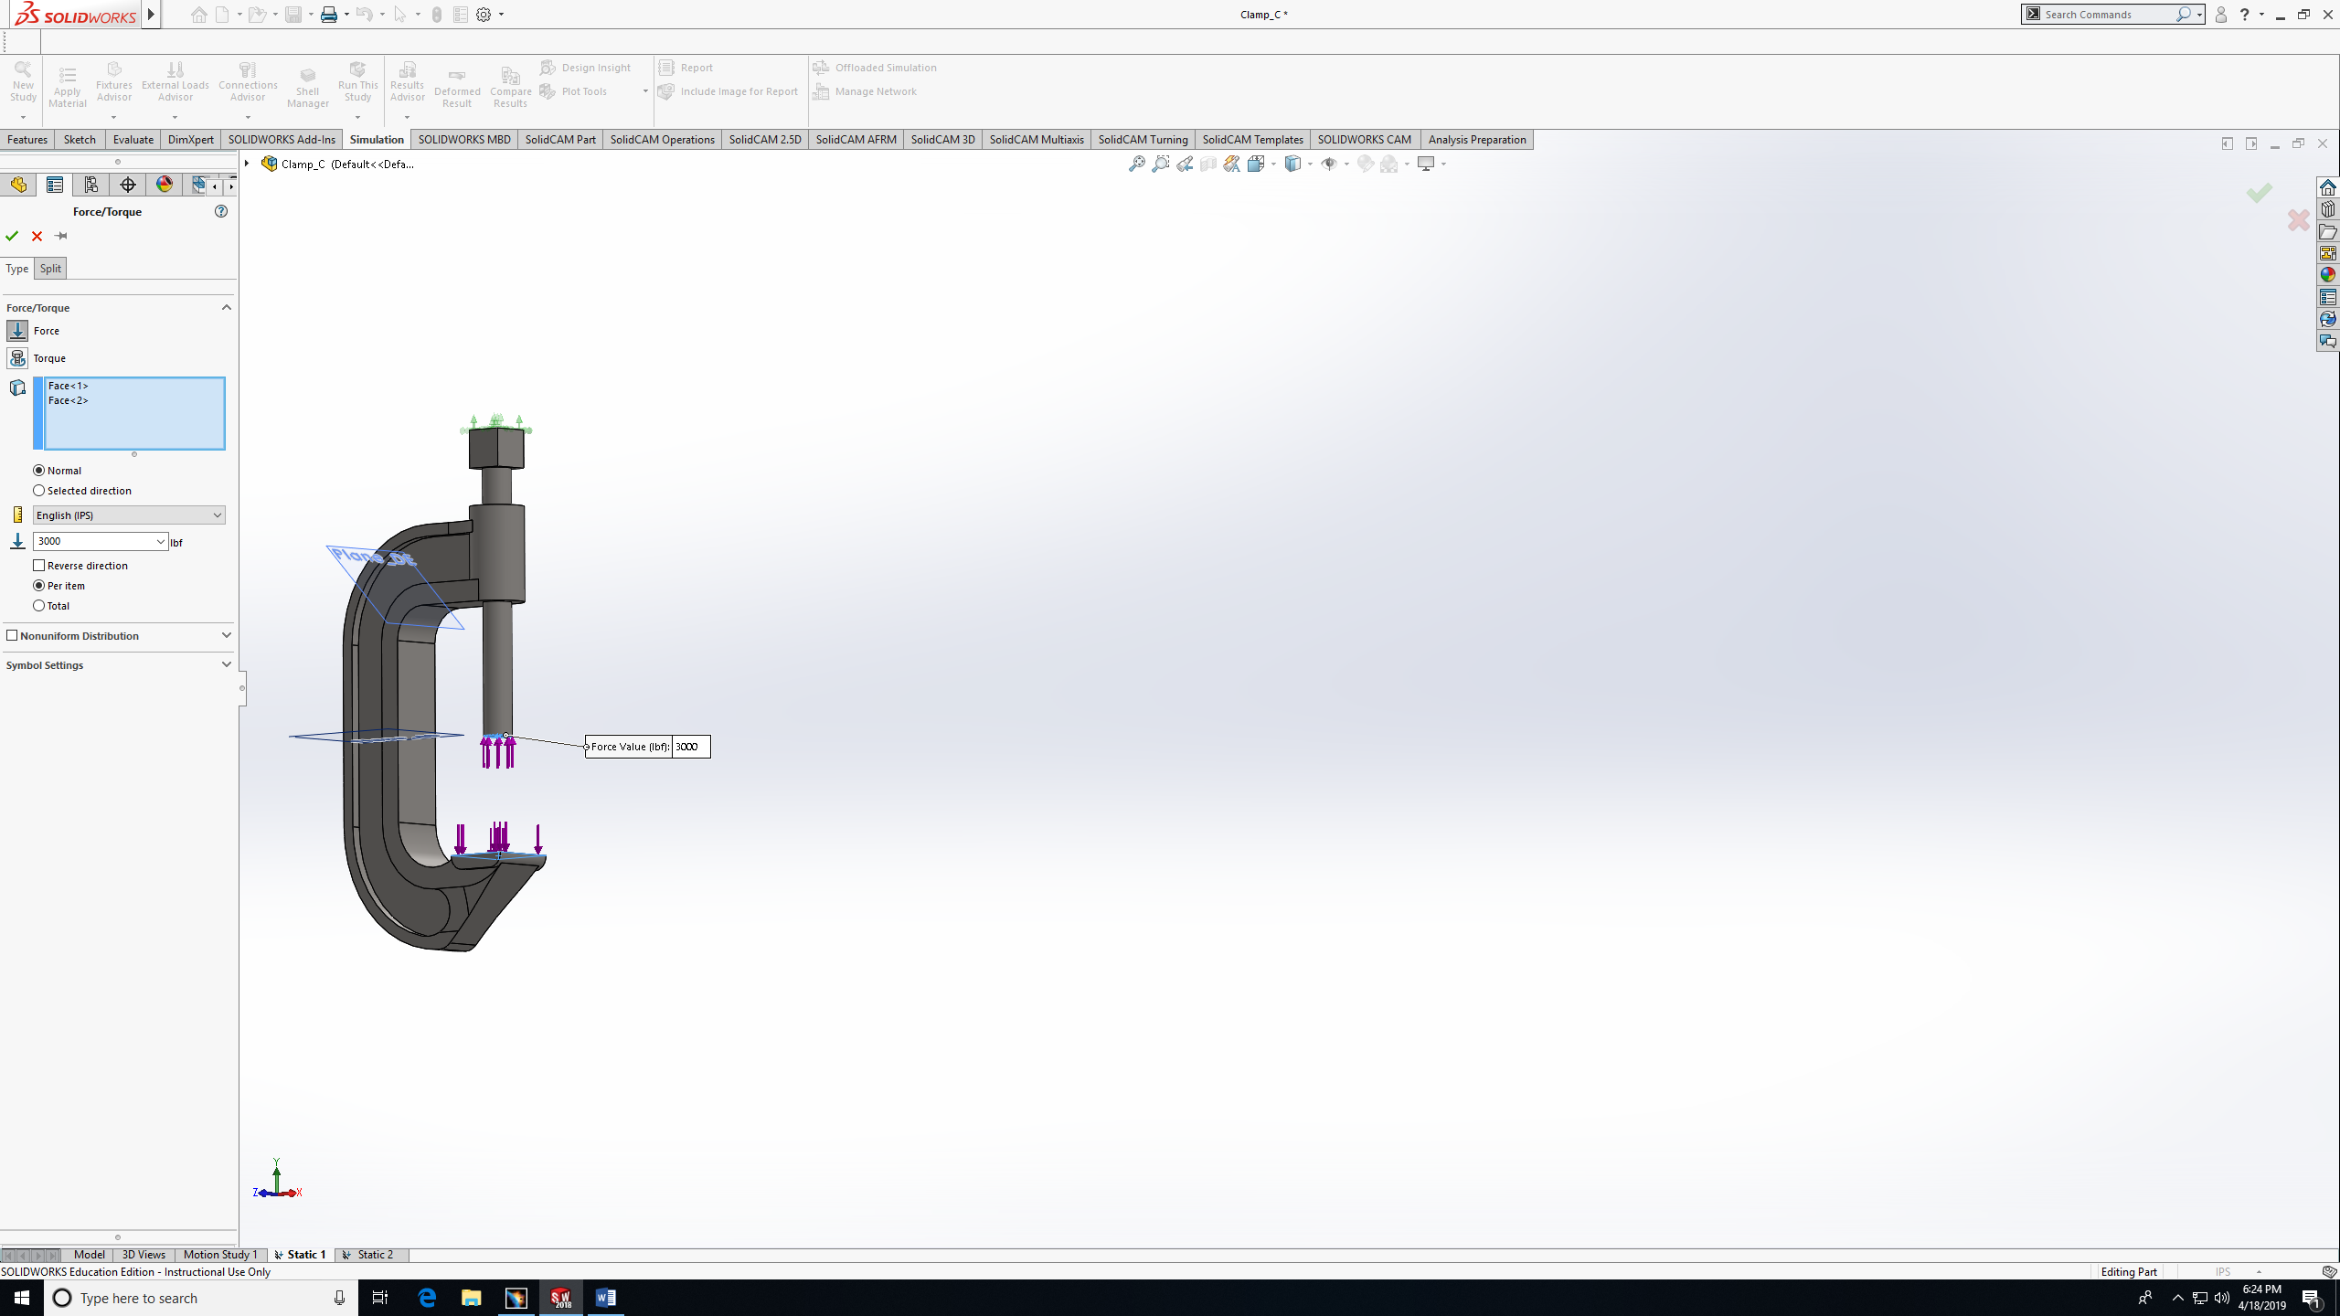
Step 4 (adding load F=3000 lb)

Slide 11
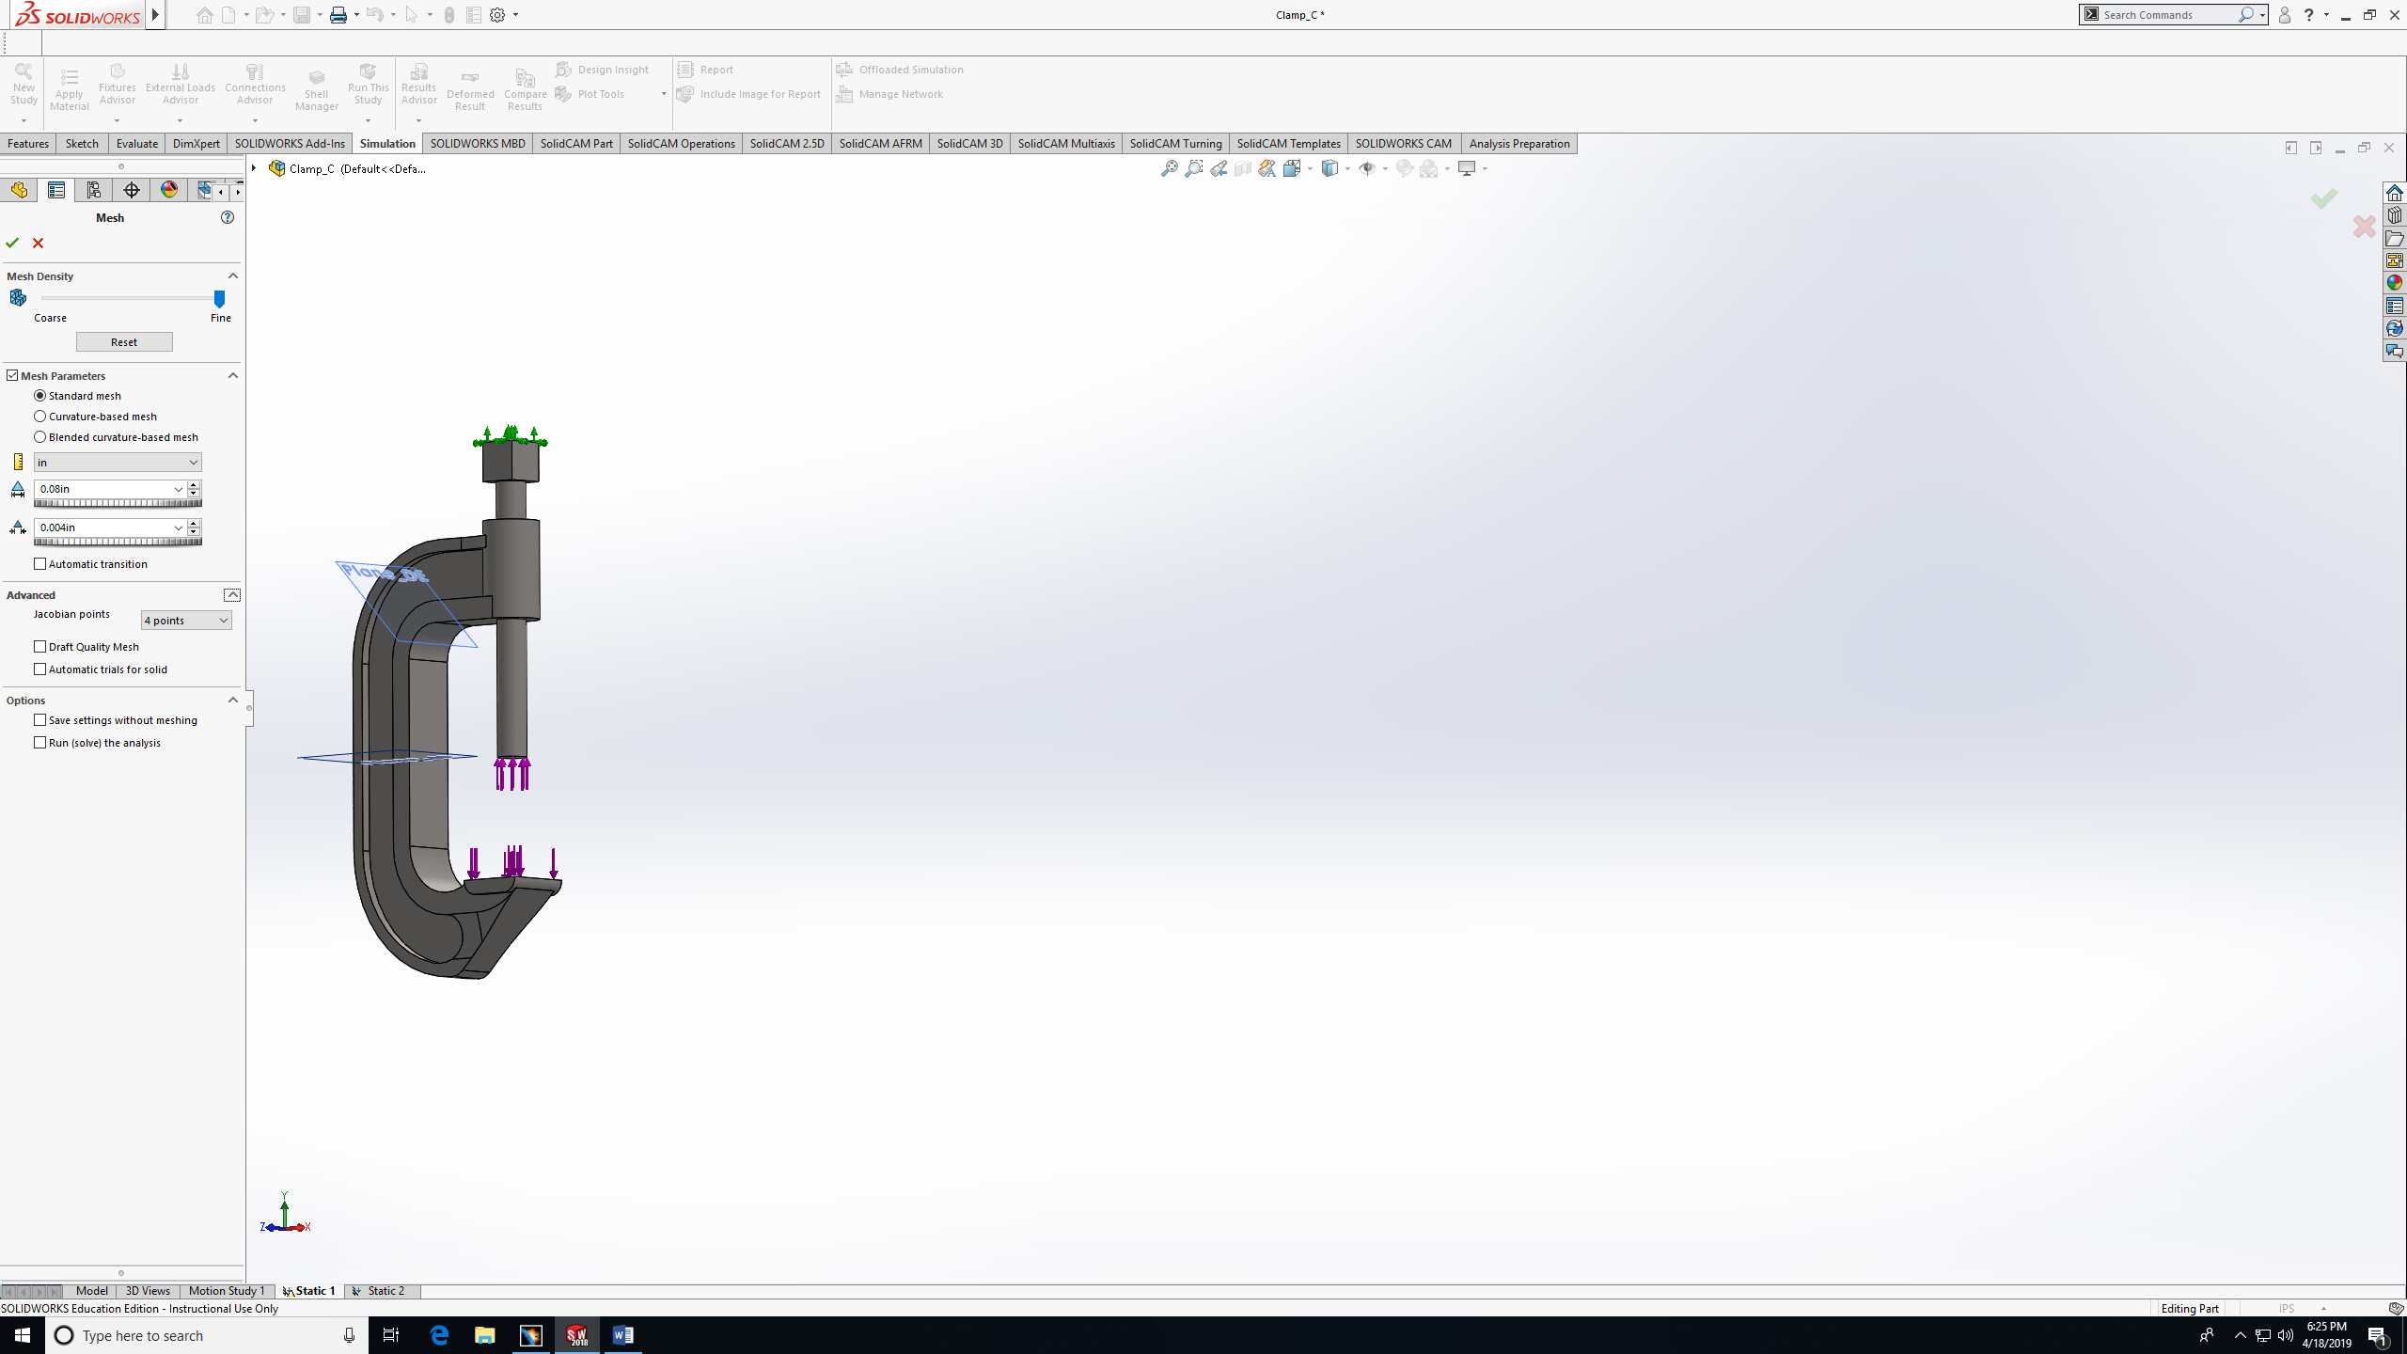
Step 5 (create mesh )

Slide 12
8 min

Slide 13
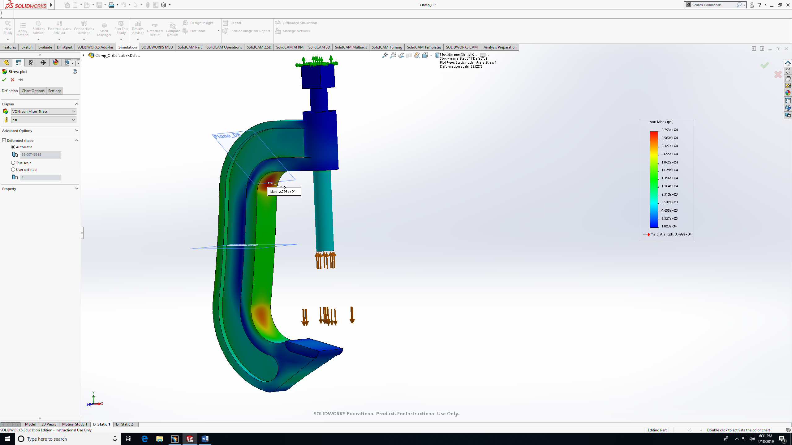
Step 5 (choose the Von-mises study)

Slide 14
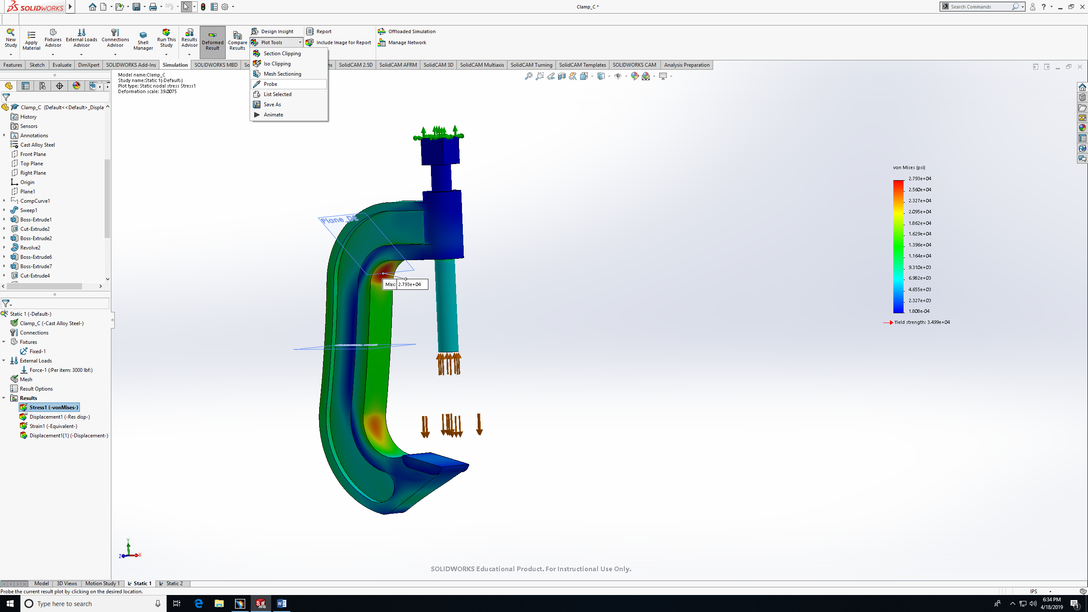
Step 6 (choose the location – using probe)

Slide 15
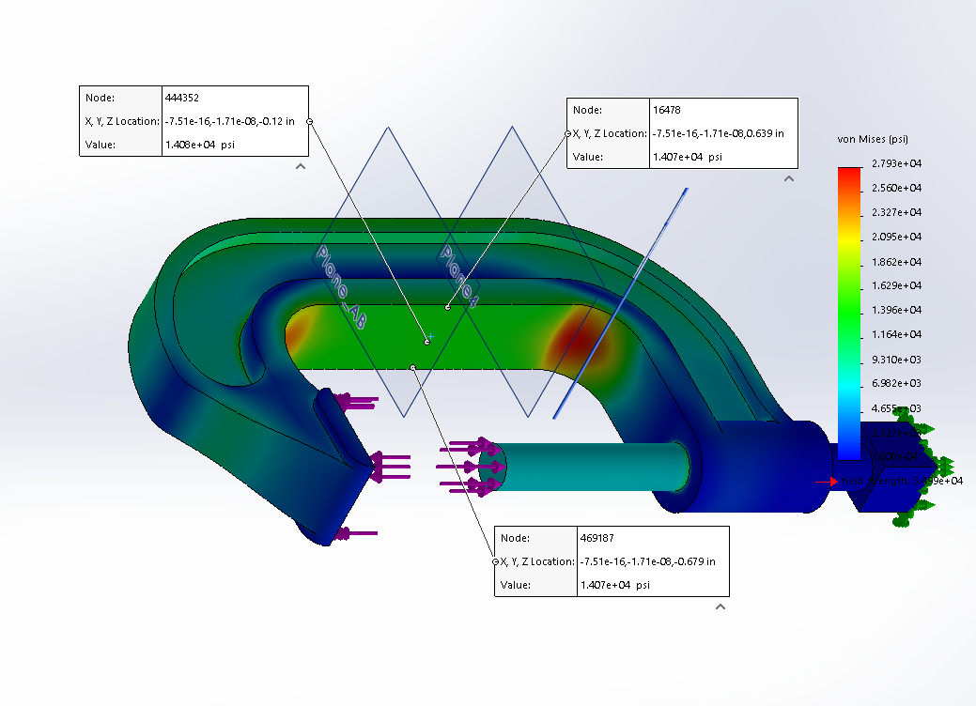
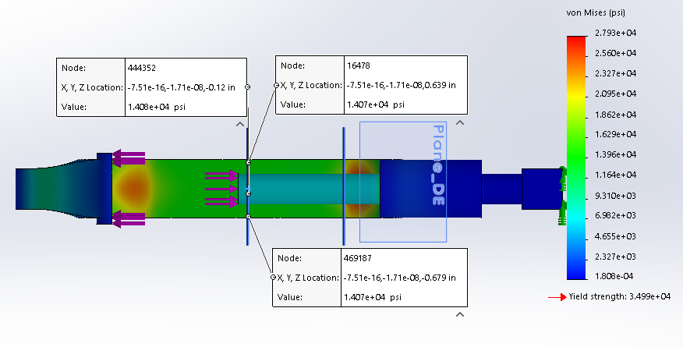
AB plane
Front
AB Inner Surface Max stress = 14,080 PSI

Slide 16
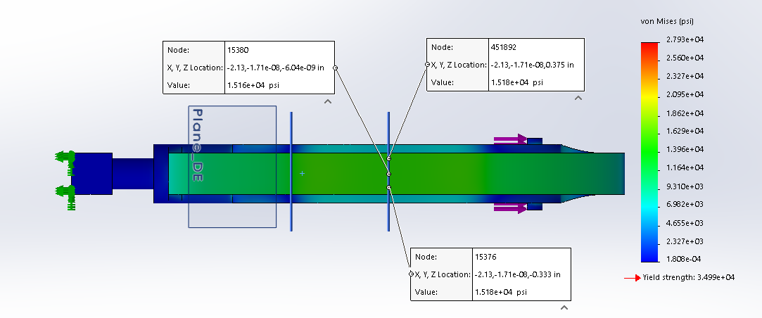
AB plane
Back
AB Outer Surface Max stress = 15,180 PSI

Slide 17
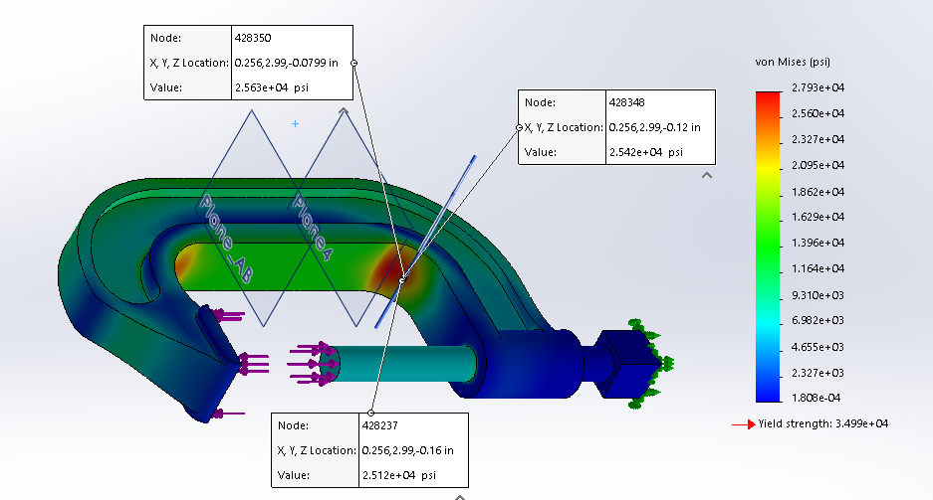
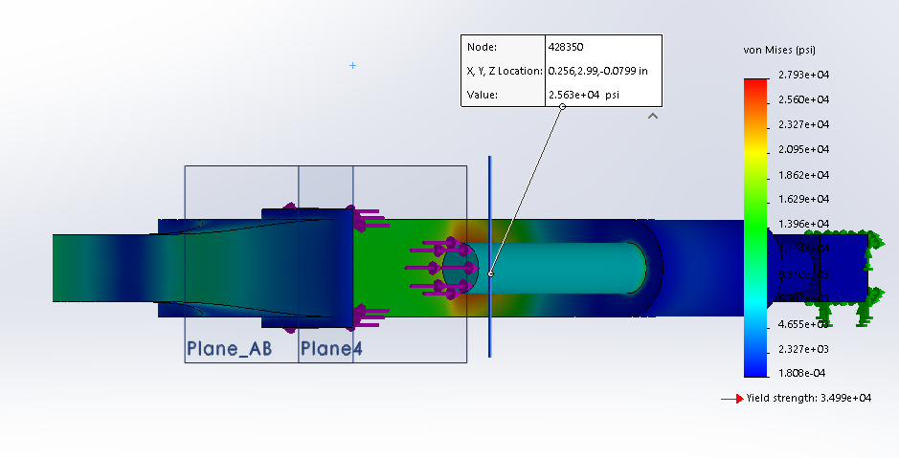
DE plane
Front
DE Inner Surface Max stress = 25,630 PSI

Slide 18
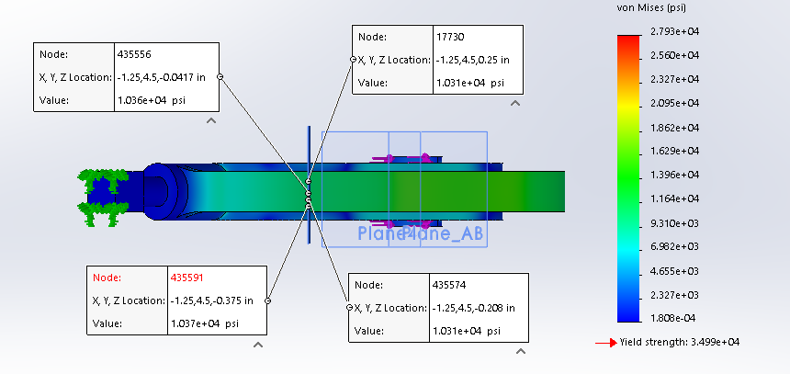
DE plane
back
DE Outer Surface Max stress = 10,370 PSI

Slide 19
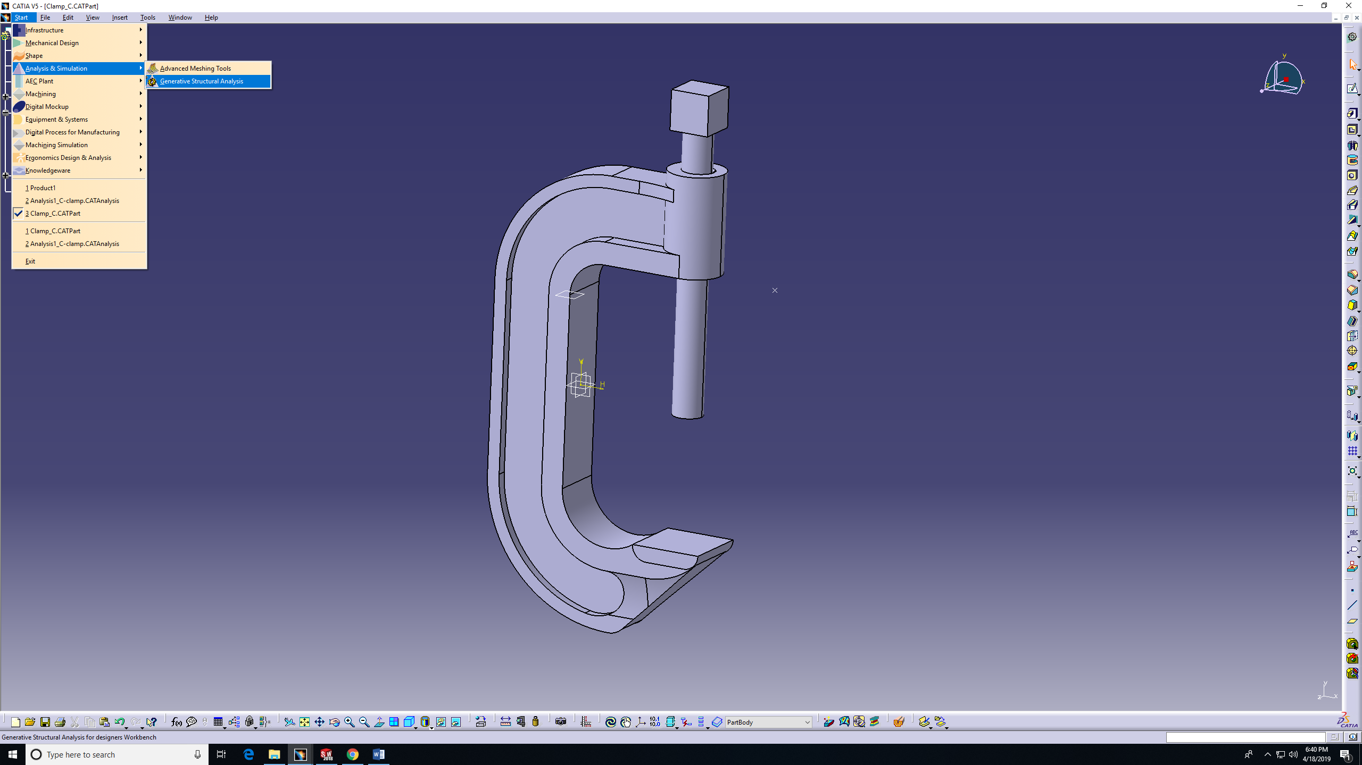
2-FEA approach in CATIA

Slide 20
Things need to do :
Mesh size
Add restraint (fixture)
Add the Load (in two steps)
Choose the Location

Slide 21
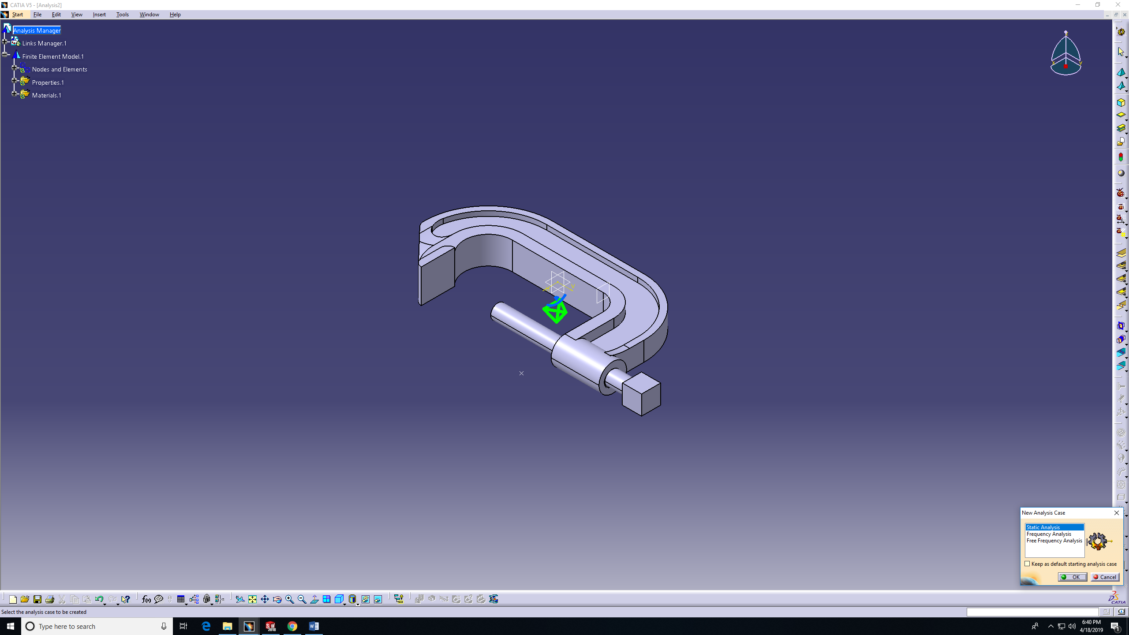
Step 1 ( static analysis)

Slide 22
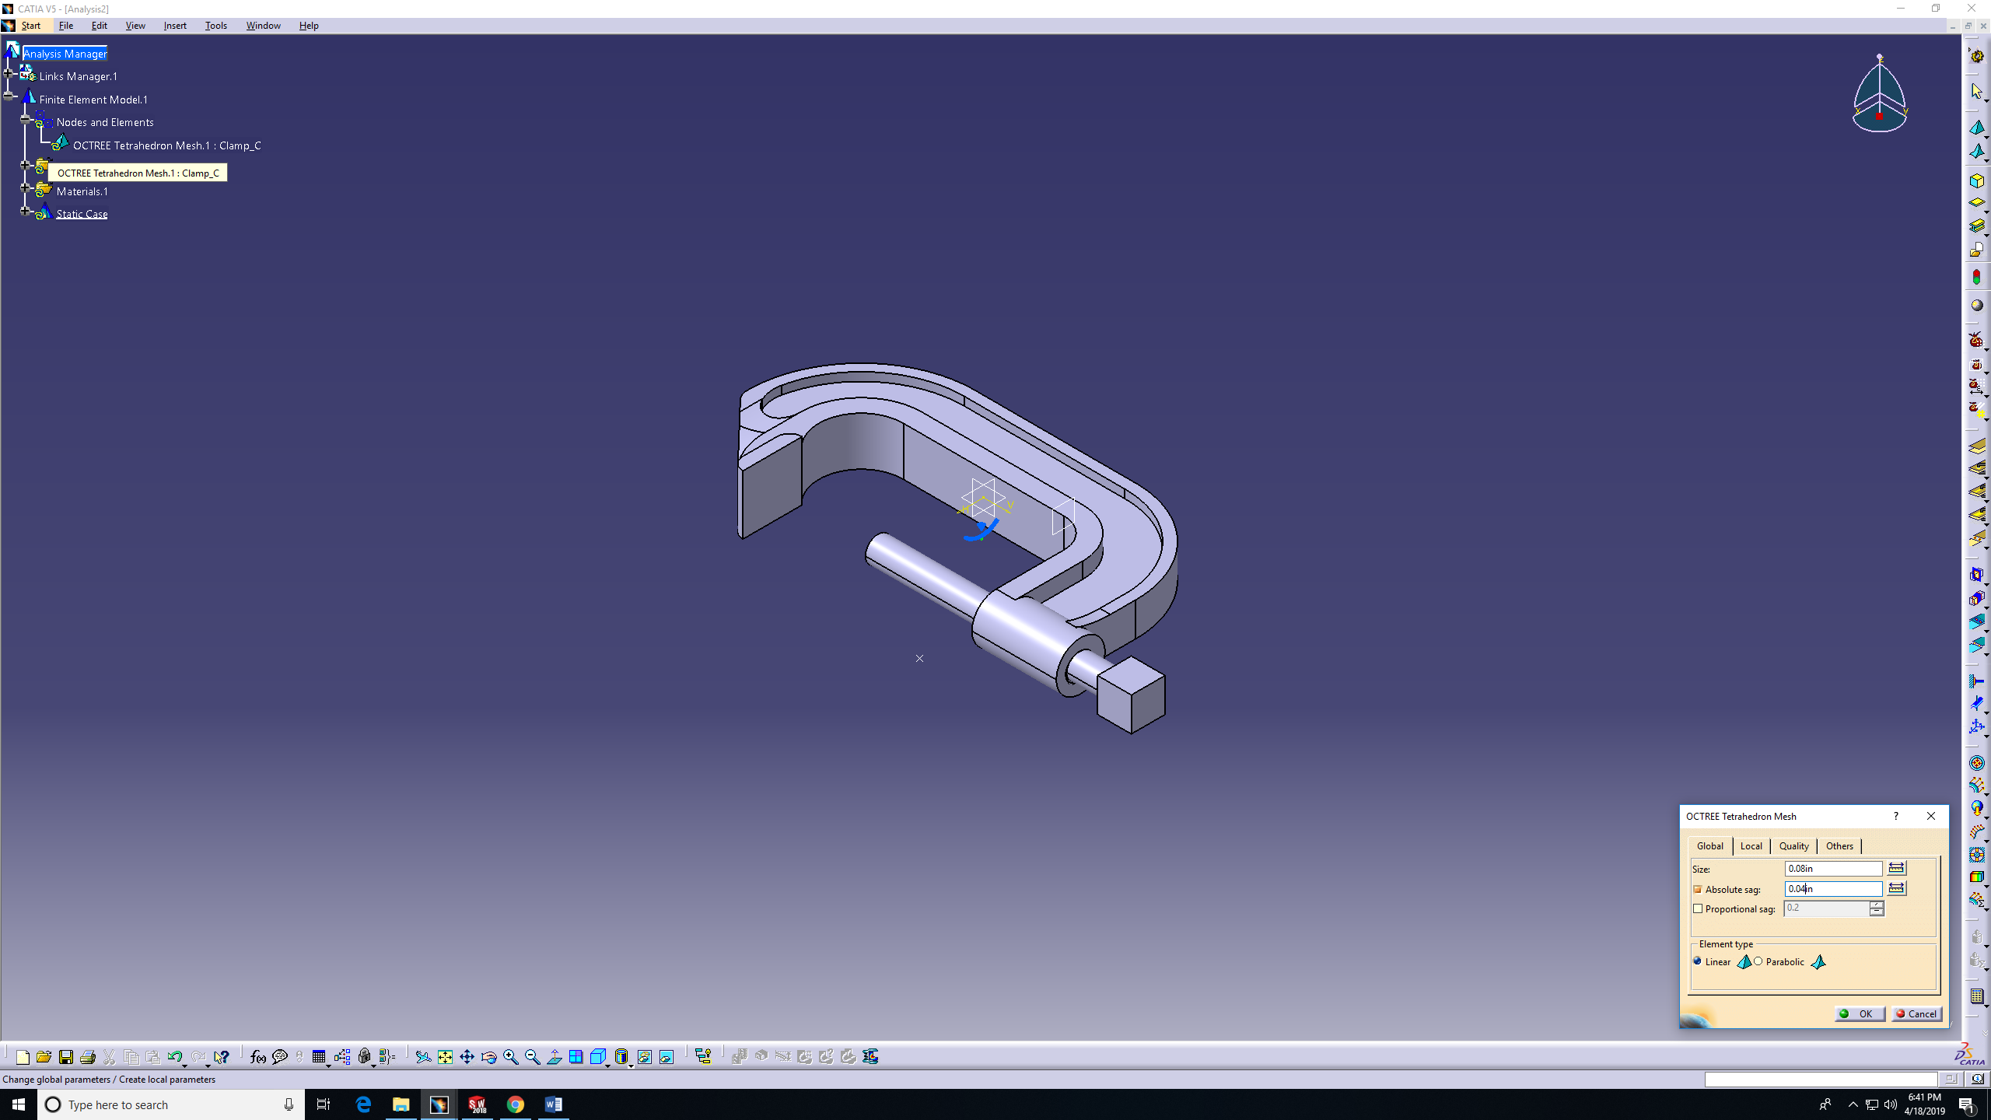
Step 2 (Mesh size)

Slide 23
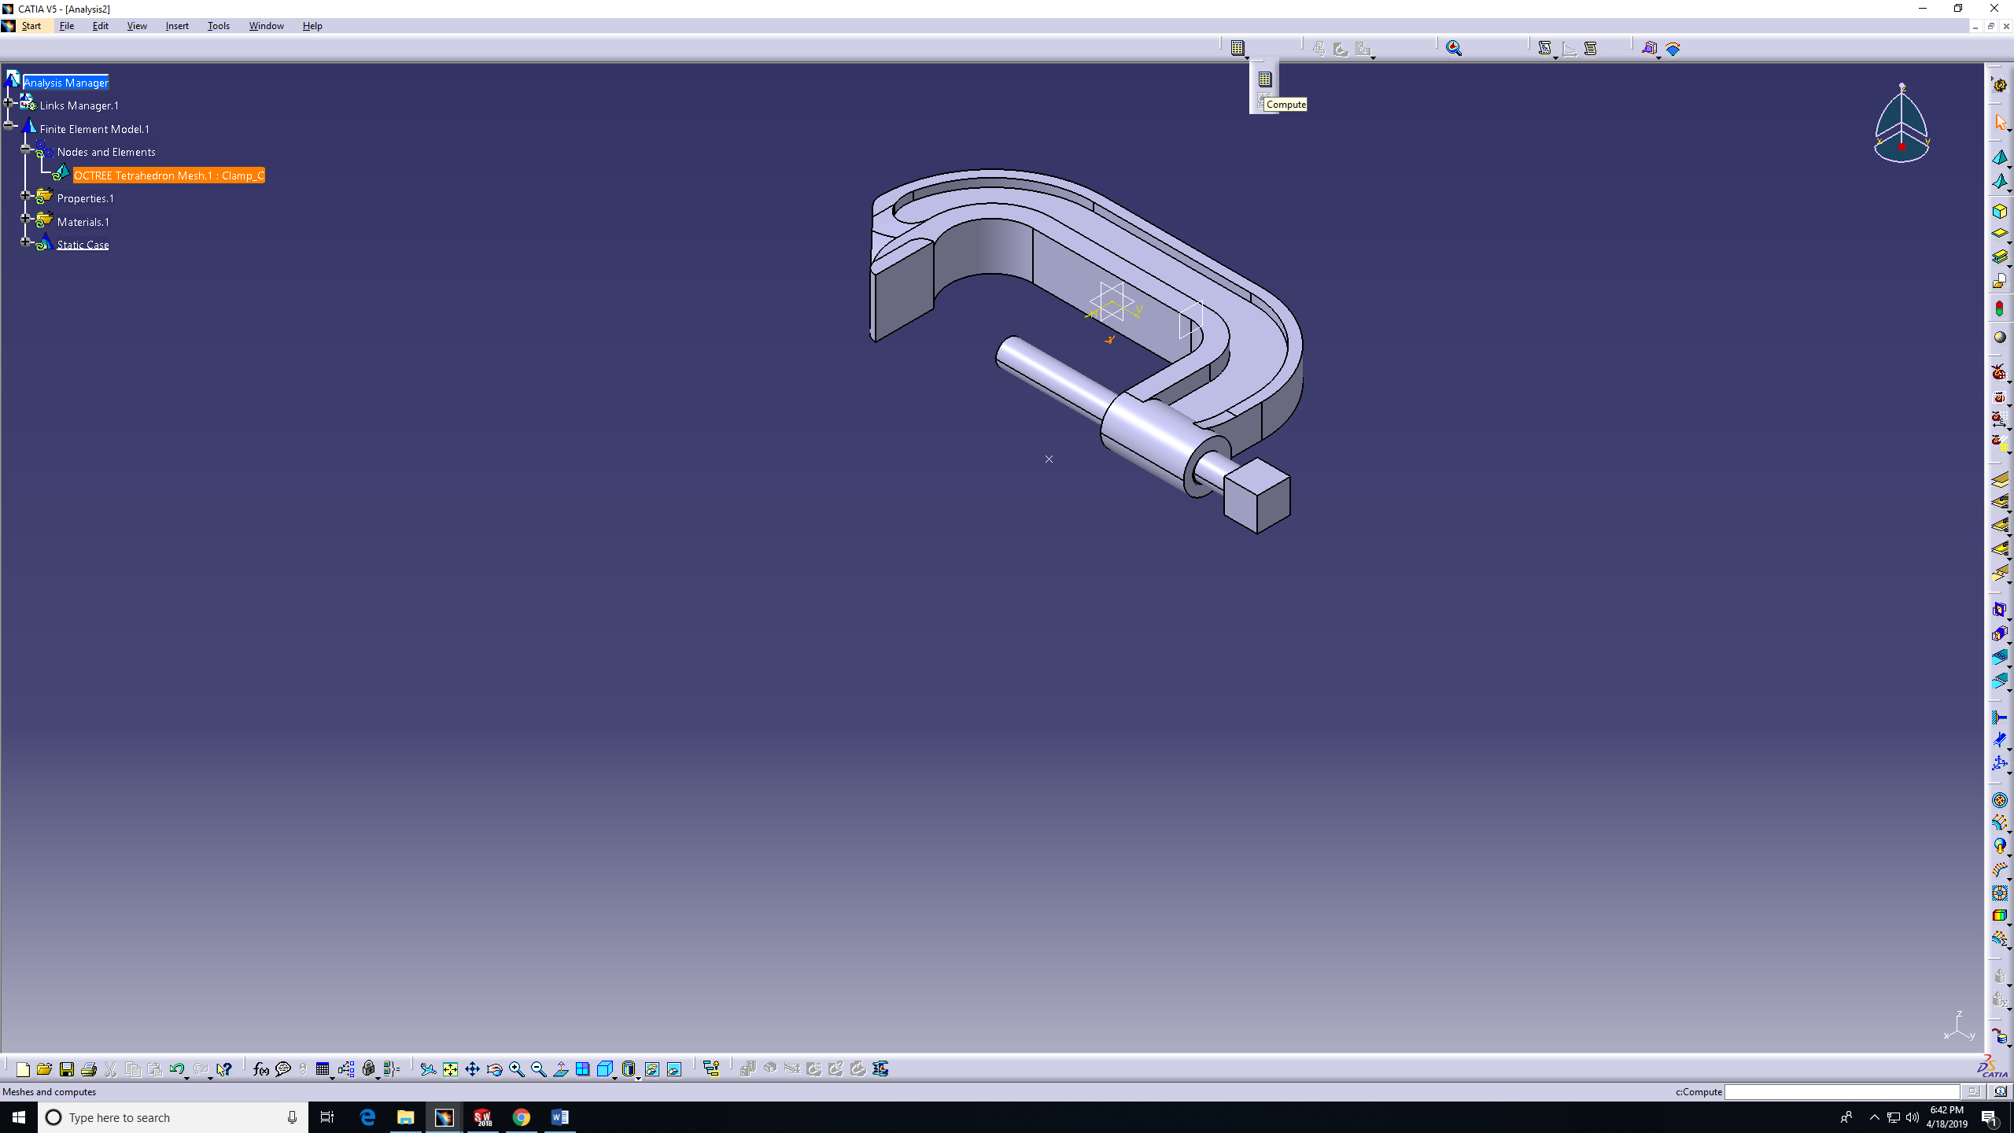
Step 3 (Compute)

Slide 24
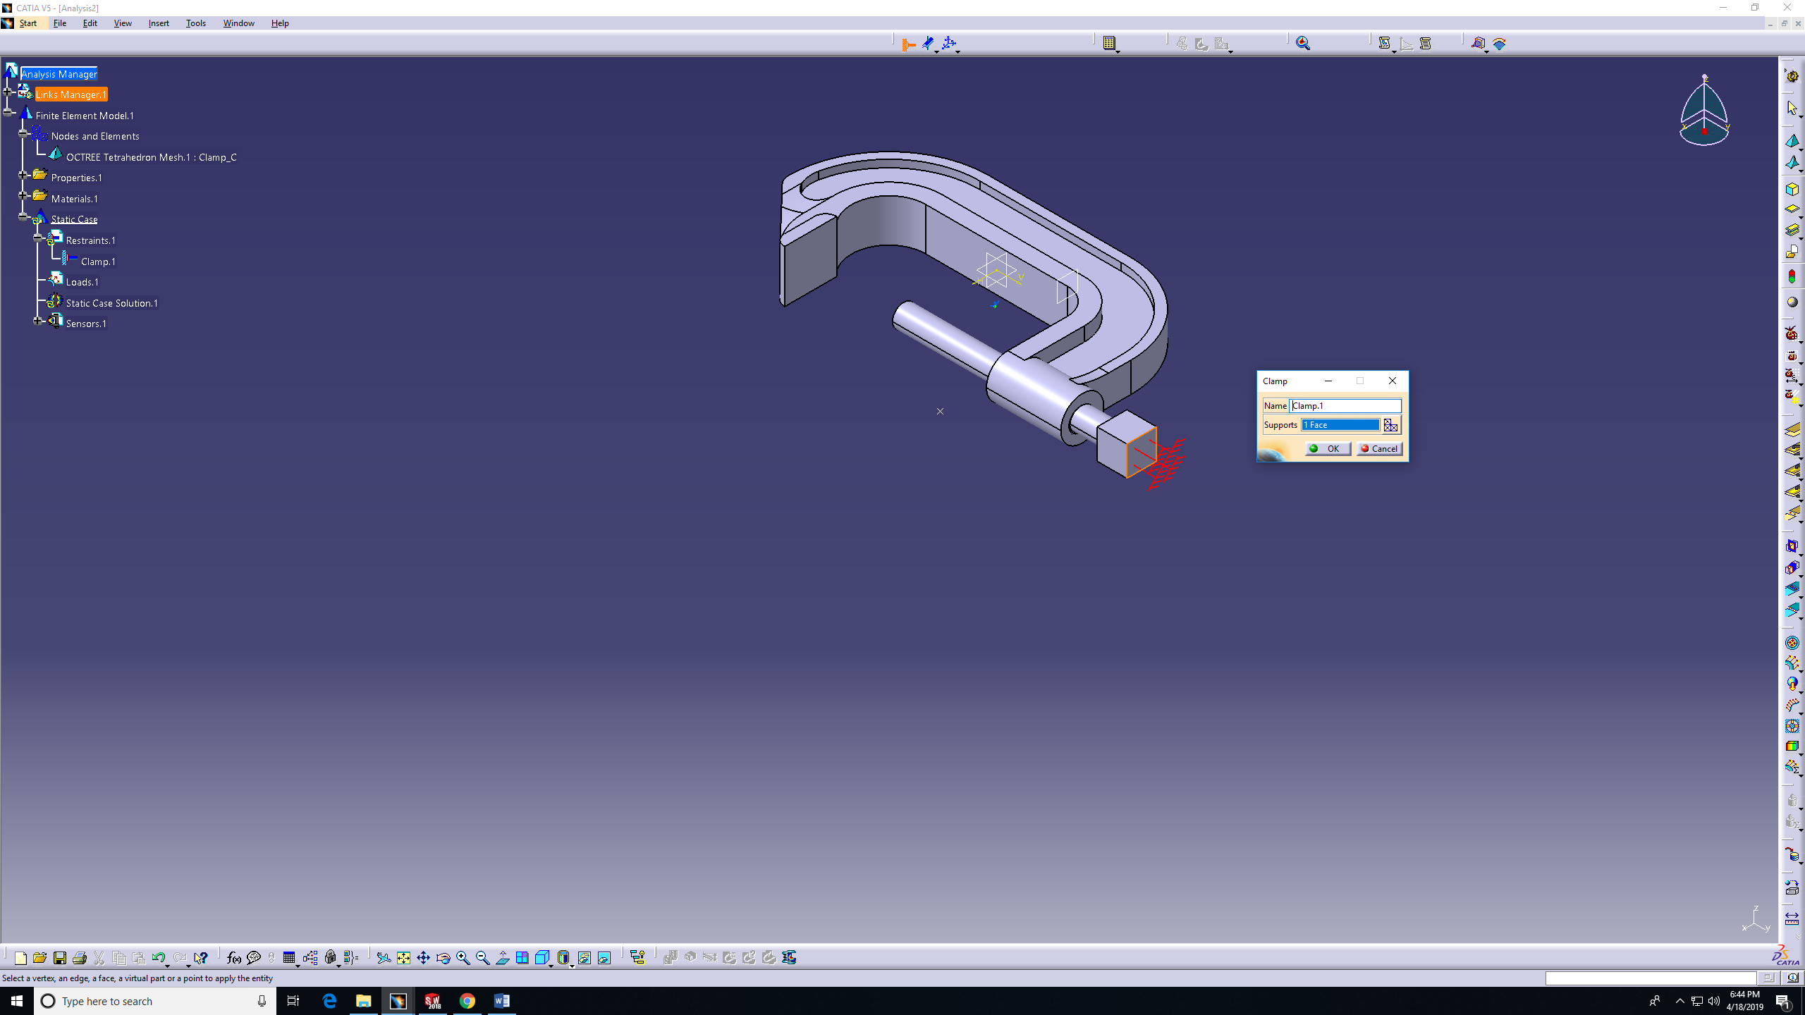
Step 4 (restraint - clamp)

Slide 25
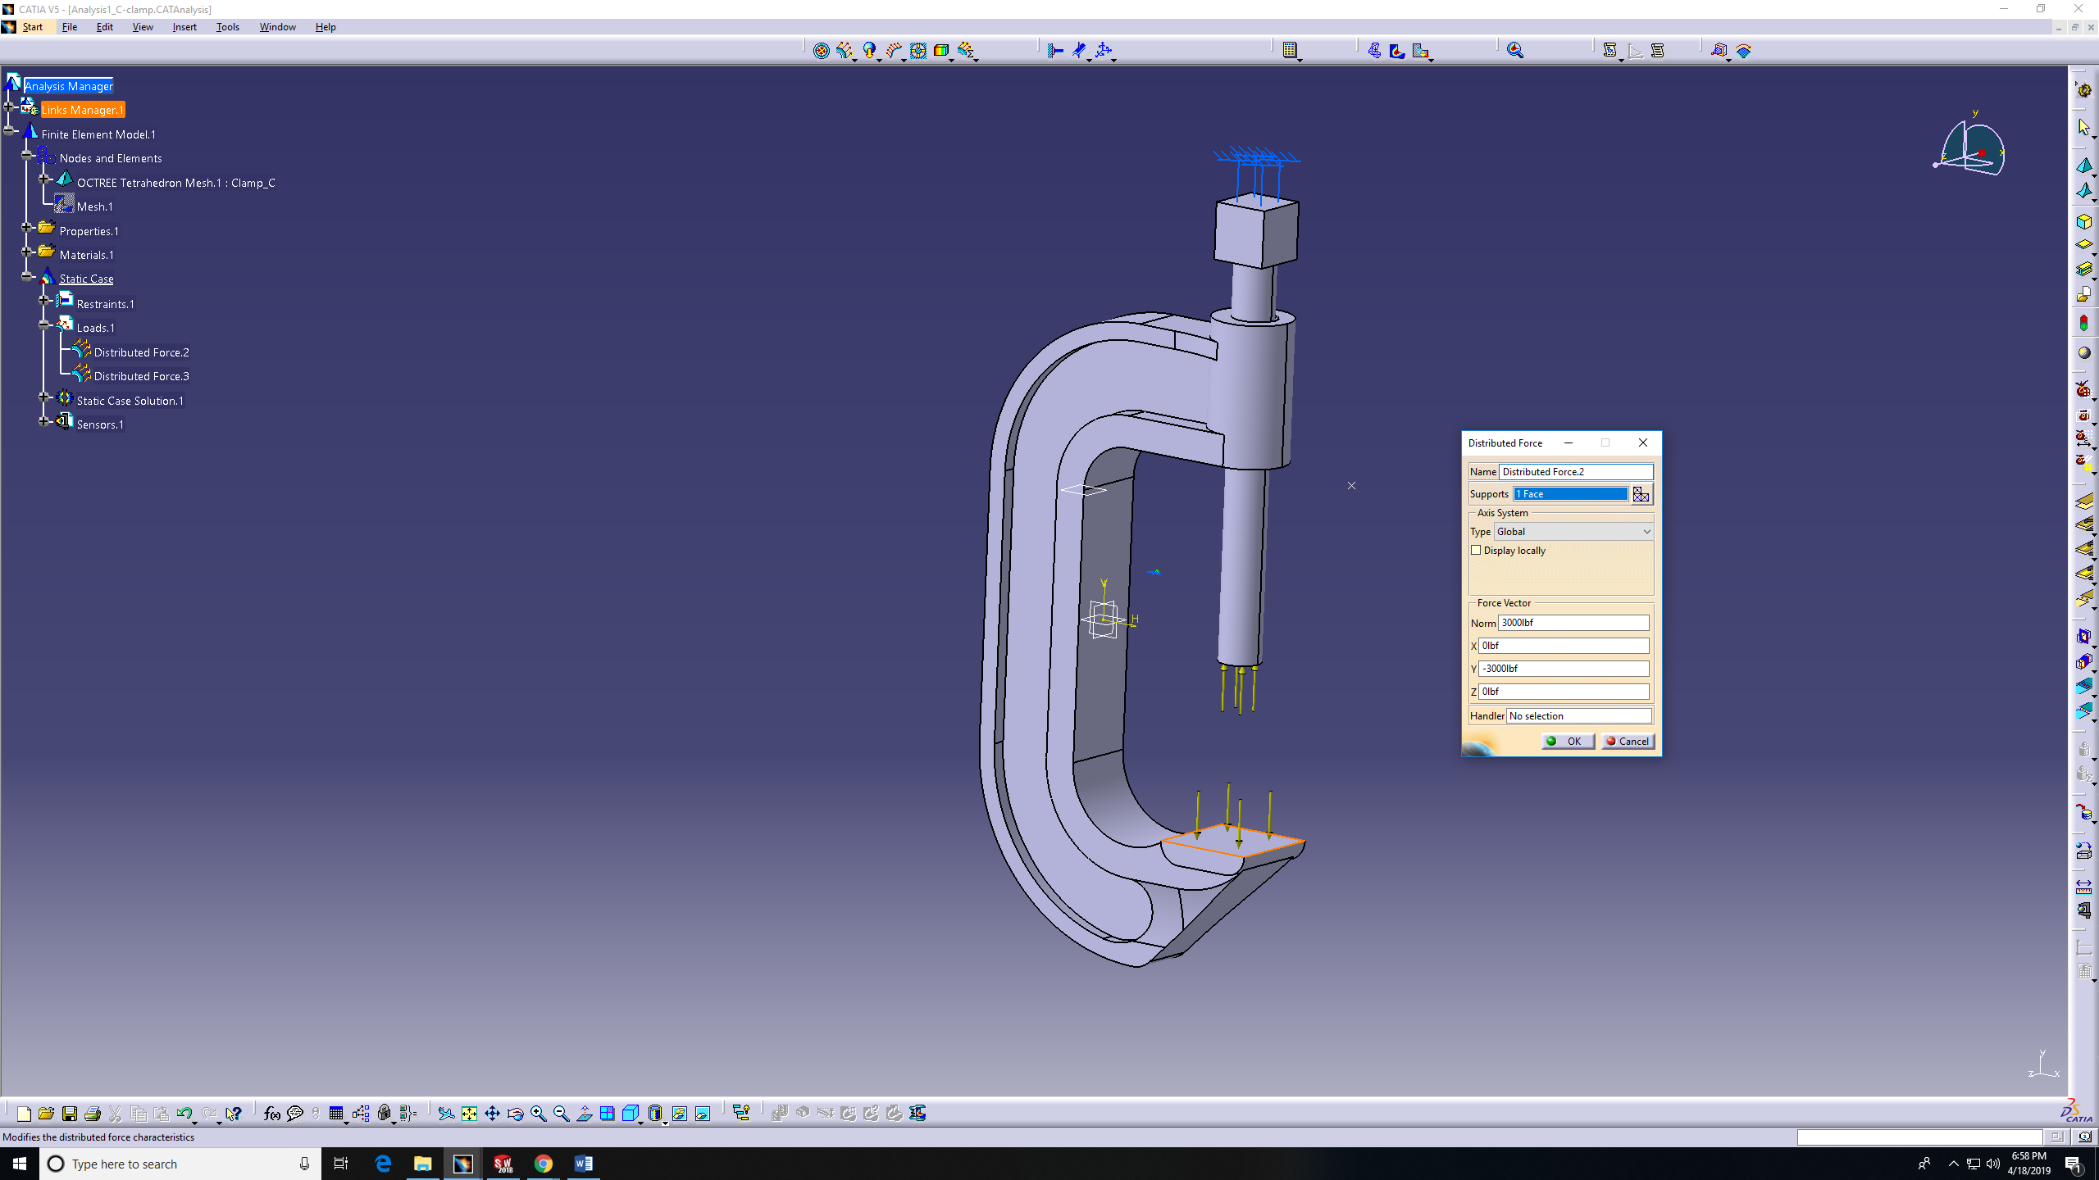
Step 5 (Add the Load - two steps)

Slide 26
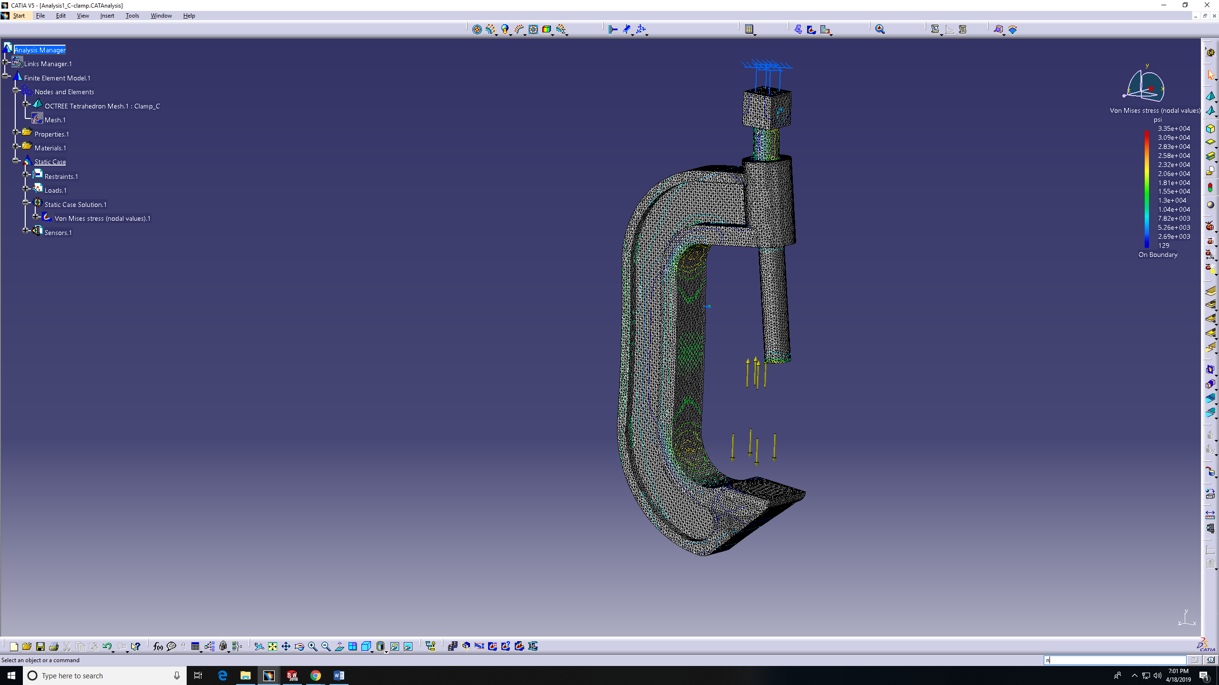
Step 6 (apply Von-mises stress)

Slide 27
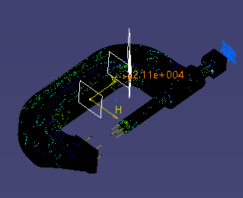
Step 6 (location)

Slide 28
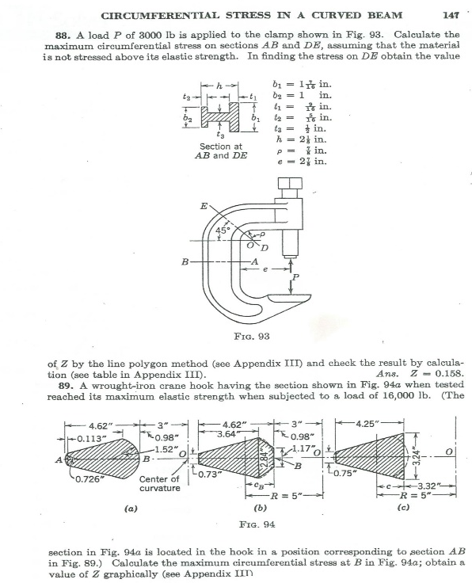
solutions
results
Location | TK (Psi)
AB inner surface | 14,227.5
AB outer surface | -15,054.8
DE inner surface | 18,408.7
DE outer surface | -9,879.8
Location | SW (Psi)
AB inner surface | 14,080
AB outer surface | -15,180
DE inner surface | 25,630
DE outer surface | -10,370
Location | Catia (Psi)
AB inner surface | 13,100
AB outer surface | -13,800
DE inner surface | 21,500
DE outer surface | -9,240

